Slide 1
Census Data Cleaning and Processing Project
Name: Manan Gupta
Batch: ME-30

Slide 2
Project Overview
Objective: Clean, process, and analyse census data from a given source.
Main Areas:
Data renaming
Missing data handling
State/UT name standardization
New state/UT formation handling
Data storage
Database connection
Querying
Goal: Ensure data uniformity, accuracy, and accessibility for further analysis.

Slide 3

part 1: Data Cleaning

Slide 4
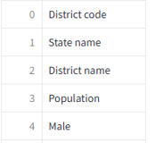
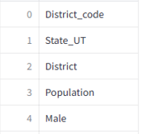
Task 1: Rename Column Names
Issue: Inconsistent Column names .
Solution: Standardize Format( e.g., “State name “ to “state_UT”)
Output :
Before Renaming
After Renaming
Renaming Columns →→

Slide 5
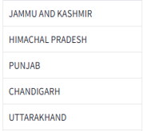
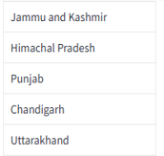
Task 2: Rename state_ut Names
Issue: State_UT names in all caps.
Solution: Capitalize first letter of each word, 'and' remains lowercase
Output :
Before Renaming
After Renaming
Renaming State name →→

Slide 6
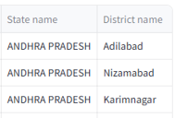
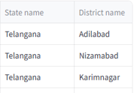
Task 3: New state_ut formation
Issue: Change state names for specific districts.
Solution: Standardize state names (e.g., 'Adilabad in AP' to 'Telangana')
Output :
Before Renaming
After Renaming
State
Name Change →→

Slide 7
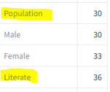
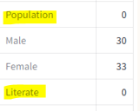
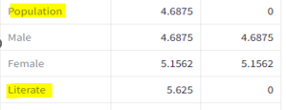
Task 4: find and process missing data
Issue: Identifying and filling missing data
Solution: Use formulas and pandas (e.g., 'Population = Male + Female')
Output :
Percentage :
Before Filling
After Filling
Before Null Value
After Null Value
Filling Values →→

Slide 8

Part 2: Database

Slide 9

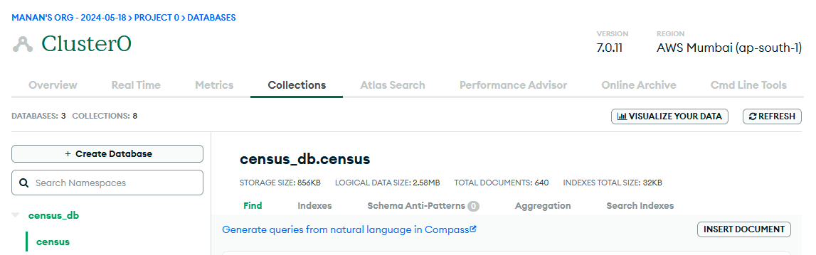
Task 5: save data into mongo db
Process: Storing cleaned data into MongoDB
Output: MongoDB layout example

Slide 10

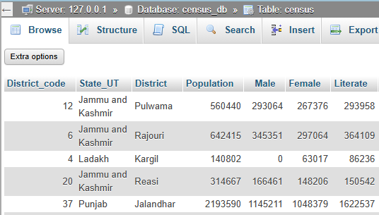

Task 6: Database connection and data upload
Process: Connecting to MongoDB and uploading data rational DB
Output: Uploaded data view example

Slide 11

Part 3: Data Analysis

Slide 12

Task 7: Run query on the db and show output on streamlit
Process:
Streamlit lacks multi-window functionality. To display query results, I used a selectbox with query options. Changing the selectbox value updates the displayed result. Query results are extracted, converted to Pandas DataFrames, and displayed in Streamlit.

Slide 13
Insights:
What is the total population of each district?
How many literate males and females are there in each district?
What is the percentage of workers (both male and female) in each district?
How many households have access to LPG or PNG as a cooking fuel in each district?
What is the religious composition (Hindus, Muslims, Christians, etc.) of each district?
How many households have internet access in each district?
What is the educational attainment distribution (below primary, primary, middle, secondary, etc.) in each district?
How many households have access to various modes of transportation (bicycle, car, radio, television, etc.) in each district?
What is the condition of occupied census houses (dilapidated, with separate kitchen, with bathing facility, with latrine facility, etc.) in each district?
How is the household size distributed (1 person, 2 persons, 3-5 persons, etc.) in each district?

Slide 14
Insights:
What is the total number of households in each state?
How many households have a latrine facility within the premises in each state?
What is the average household size in each state?
How many households are owned versus rented in each state?
What is the distribution of different types of latrine facilities (pit latrine, flush latrine, etc.) in each state?
How many households have access to drinking water sources near the premises in each state?
What is the average household income distribution in each state based on the power parity categories?
What is the percentage of married couples with different household sizes in each state?
How many households fall below the poverty line in each state based on the power parity categories?
What is the overall literacy rate (percentage of literate population) in each state?

Slide 15


